Slide 1

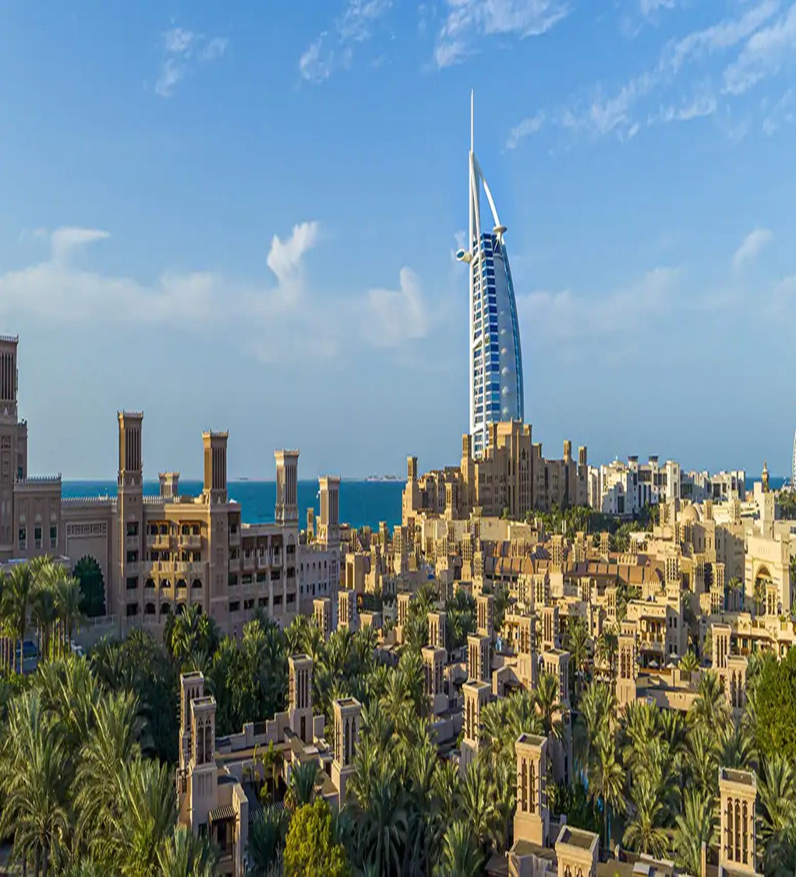
Dubai
The UAE(United Arab Emirates) Consists of Seven emirates - Abu Dhabi, Dubai, Sharjah, Ajman, Umm Al-Quwain, and Fujairah, Ras Al Khaimah.
Dubai is the most populous city in the United Arab Emirates (UAE)

Slide 2
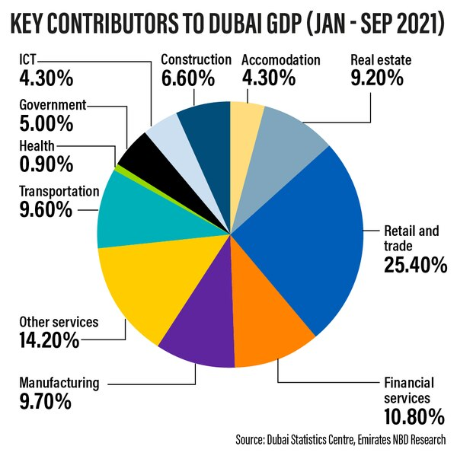
Business of Dubai
The UAE's oil and gas sector is its most important industry.
Tourism Industry is the UAE's Biggest Source of Income
Dubai's largest industries include construction and real estate, tourism and hospitality, technology, and finance.
From oil and gas to construction, tourism, real estate, logistics and transportation, financial services, healthcare, and retail – all these sectors play an essential role in the country's economy in Dubai.

Slide 3
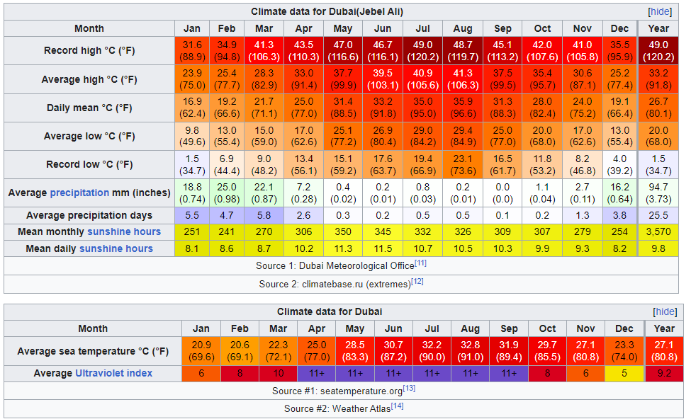
Climate, Race
Dubai has a hot arid climate. Dubai has 2 seasons – winter and summer.
Summer in Dubai begins around the last week of April and ends around the first week of October.
This period is characterized by extremely hot weather, hot winds, and high humidity.
Winter in Dubai begins around the last week of October and lasts until the beginning of April.
Winter in Dubai begins around the last week of October and lasts until the beginning of April.
Most of the precipitation takes place during this season

Slide 4
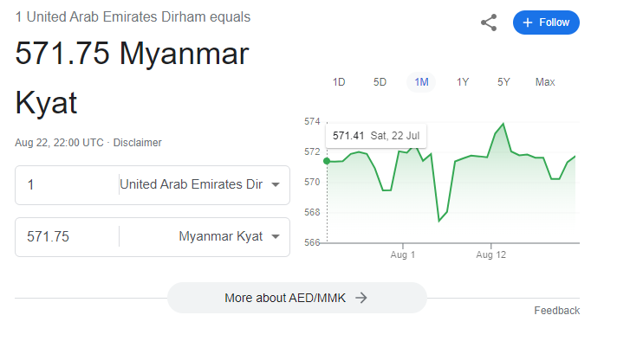
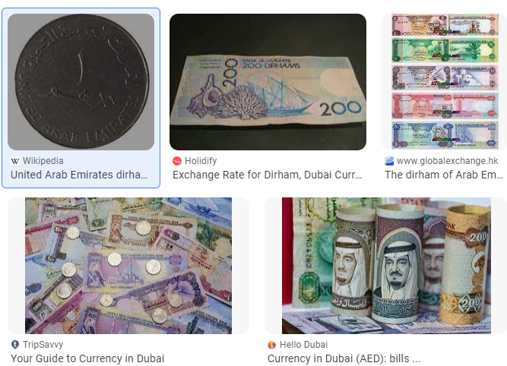
Currency of Dubai
AED is the currency abbreviation for the United Arab Emirates dirham, the official currency of Dubai and other Emirates.
The symbol is Dhs or DH.

Slide 5
Time difference
The time difference between Myanmar and the United Arab Emirates is 2.5 hours (s).
Myanmar (Burma) is 2 hours and 30 minutes ahead of Dubai.
While in Myanmar the actual local time is 06:30,
in the United Arab Emirates the time is 04:00.
05:01 Wednesday, in Myanmar (Burma) is
02:31 Wednesday, in Dubai - United Arab Emirates

Slide 6


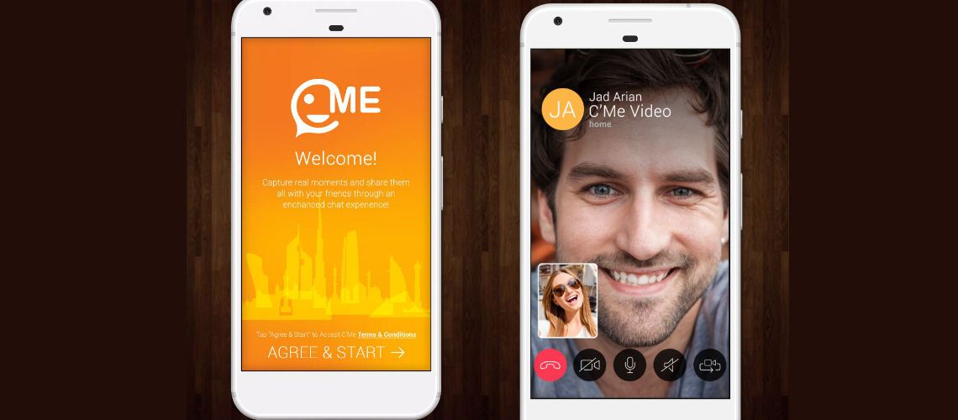
Which app people use in Dubai?
INTERNET CALLING APPS IN THE UAE
BOTIM. BOTIM is one of the best internet calling apps in the UAE. ...
C'ME. Another one of the UAE internet calling apps, C'ME offers an alternative for residents looking to make international calls for cheap prices.

Slide 7
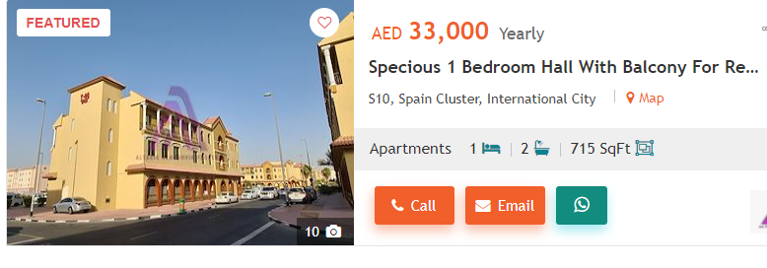
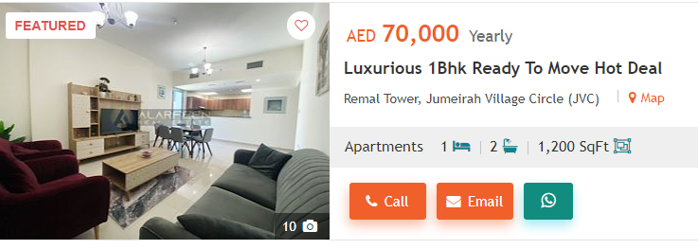
Residential

Slide 8
Employment Visa
Your employer has to obtain the work permit on your behalf.
The fees for UAE work permits are Category 1: AED 300,
Category 2:
    Level A: AED 600
    Level B: AED 1,500
    Level C: AED 2,000
  Category 3: AED 5,000
Foreign workers are divided into three categories, based on their academic qualifications/skill sets:
  Category 1: If you have at least a bachelor’s degree
  Category 2: If you have a post-secondary diploma in any field
  Category 3: If you have a high school diploma
A work permit, when you first receive it is valid for 30 days, and can be extended for another 30. This gives you 60 days to remain in the country, during which time you and your employer have to arrange to get a Residence Visa, an Emirates ID, and your Labour Card.
UAE Residence Visas are issued for 1, 2, or 3 years
It is usually the company that has hired you which pays all the visa fees and work permit costs.
It usually takes about 5 working days for the Ministry to issue the work permit.

Slide 9
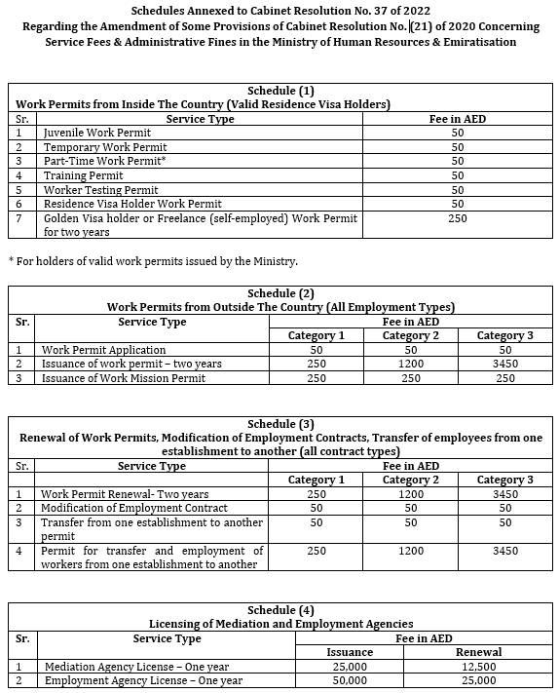

Slide 10

Language
Dubai's official language is Arabic but there are many variations prevalent in the city
English is the most commonly spoken language in Dubai. you'll find it easy to make your way around. From road signs and menus to phone directories and public transport, English is always an option. All members of the service industry also speak the language, so you can order, shop and explore with ease

Slide 11
Dubai(Jobwesite)
GulfTalent (www.gulftalent.com)
Naukri Gulf (www.naukrigulf.com)
LinkedIn (www.linkedin.com)
Monster Gulf (www.monstergulf.com)
Dubizzle (www.dubizzle.com)
Indeed UAE (www.indeed.ae)
Bayt (www.bayt.com)
1. Sign up 2. Edit Profile 3. Applying for job 4. Applied Job History

Slide 12
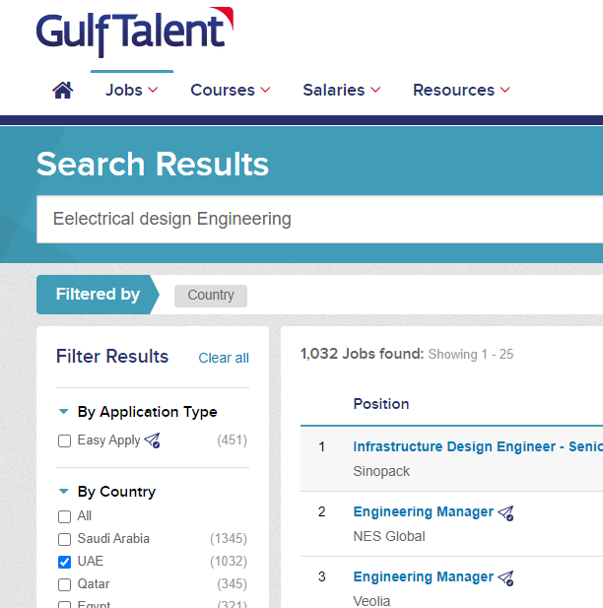

(www.gulftalent.com) GulfTalent

Slide 13
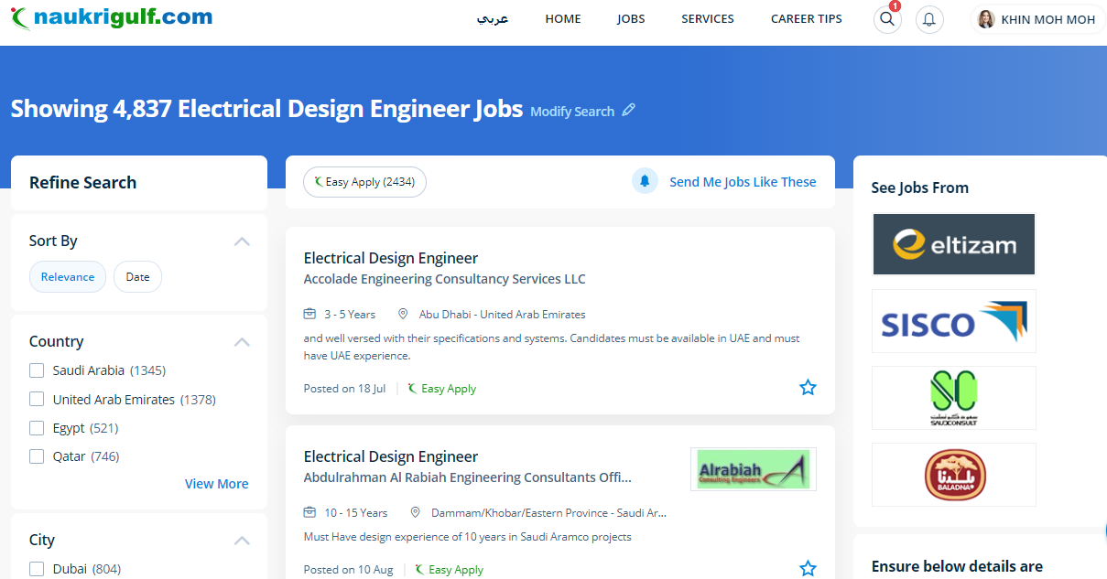
Naukri Gulf (www.naukrigulf.com)

Slide 14
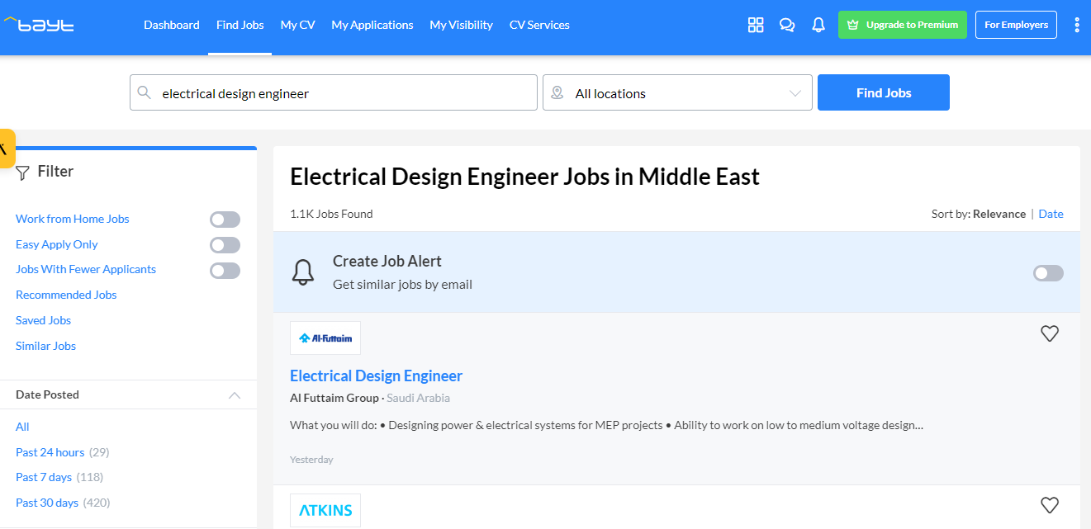
Bayt (www.bayt.com)

Slide 15
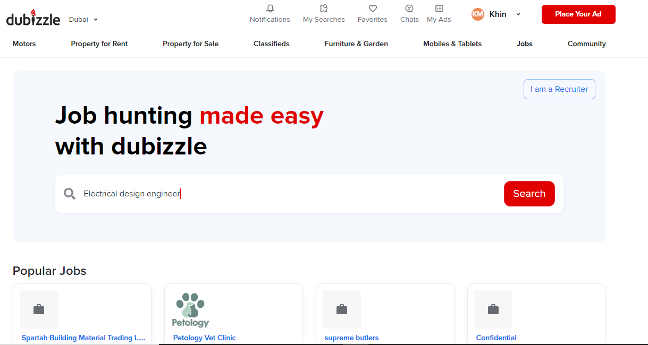
Dubizzle (www.dubizzle.com)

Slide 16
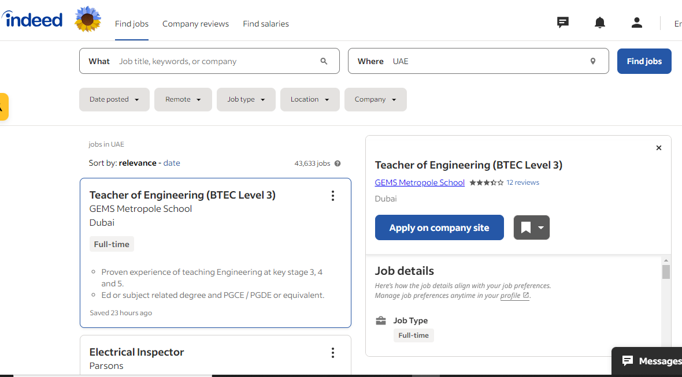
Indeed UAE (www.indeed.ae)

Slide 17

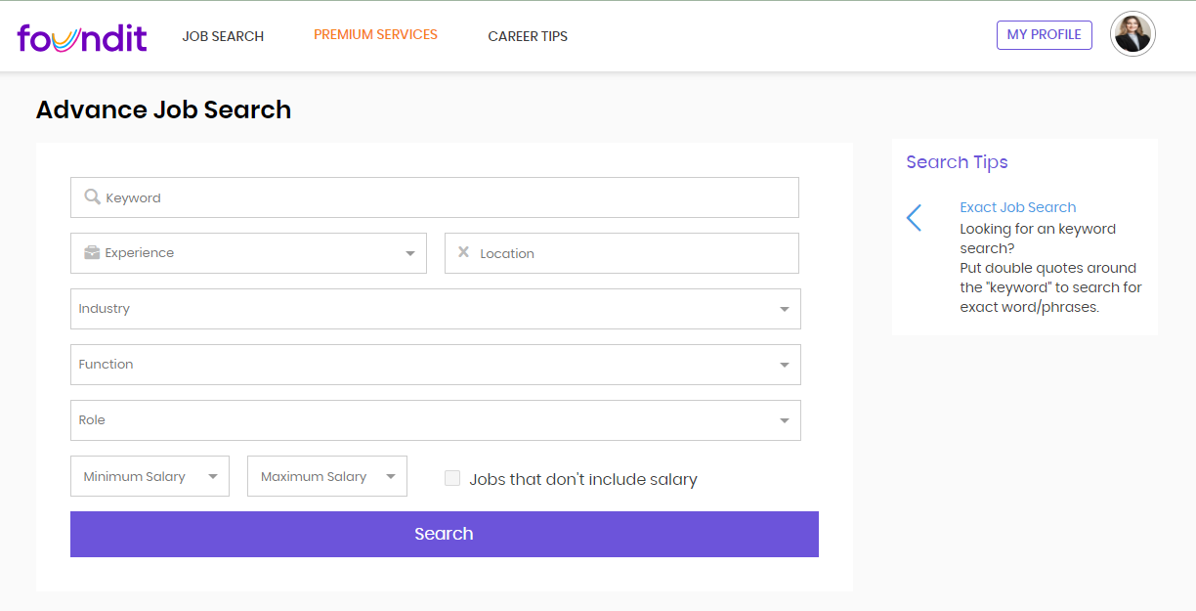
Monster Gulf (www.monstergulf.com)

Slide 18


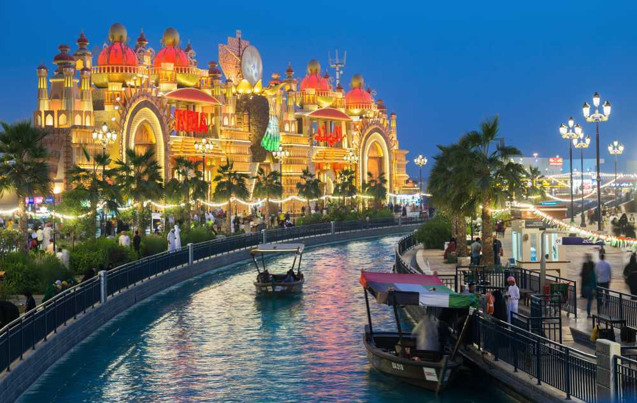
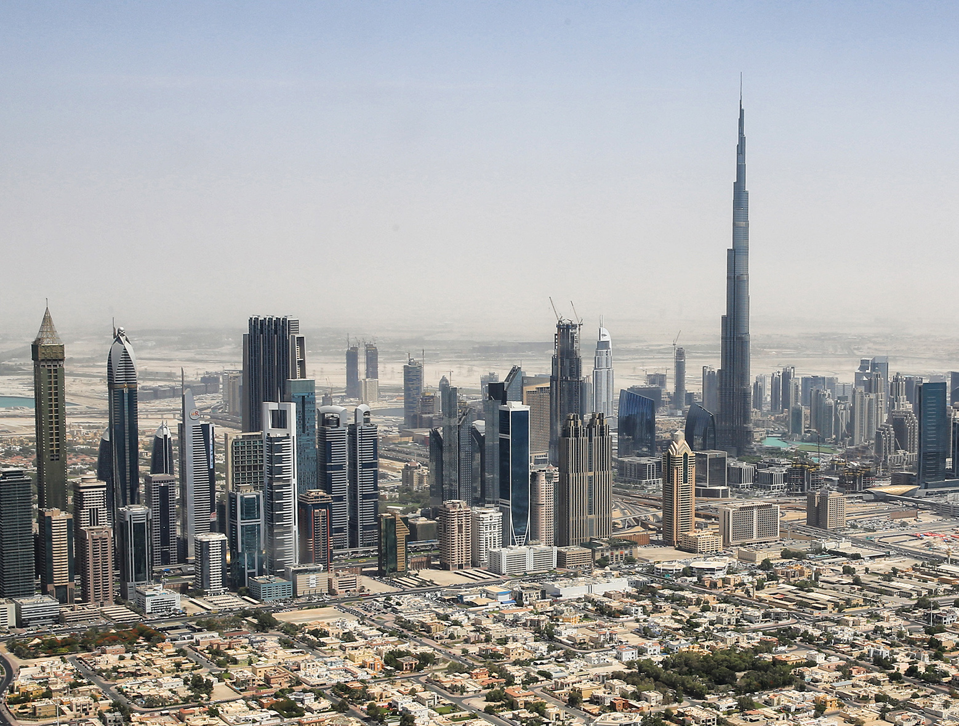
Success

